Slide 1
Genetic algorithm for quantum architechture search
Vu Tuan Hai
19/9/2023

Slide 2
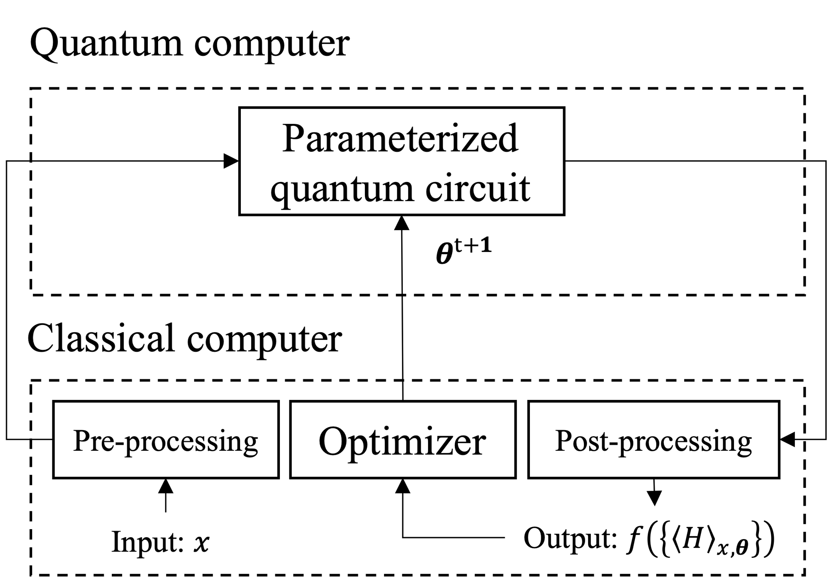



1. Prob: reconstruct arbitrary state
Encoding desired state into quantum circuit is an important component in quantum machine learning problems.
$$⋮$$
Encoder
$$⋮$$
Fig 1.1. Hybrid model [1]
[1] M. Schuld and F. Petruccione, Machine learning with quantum computers (Springer, 2021).

Slide 3
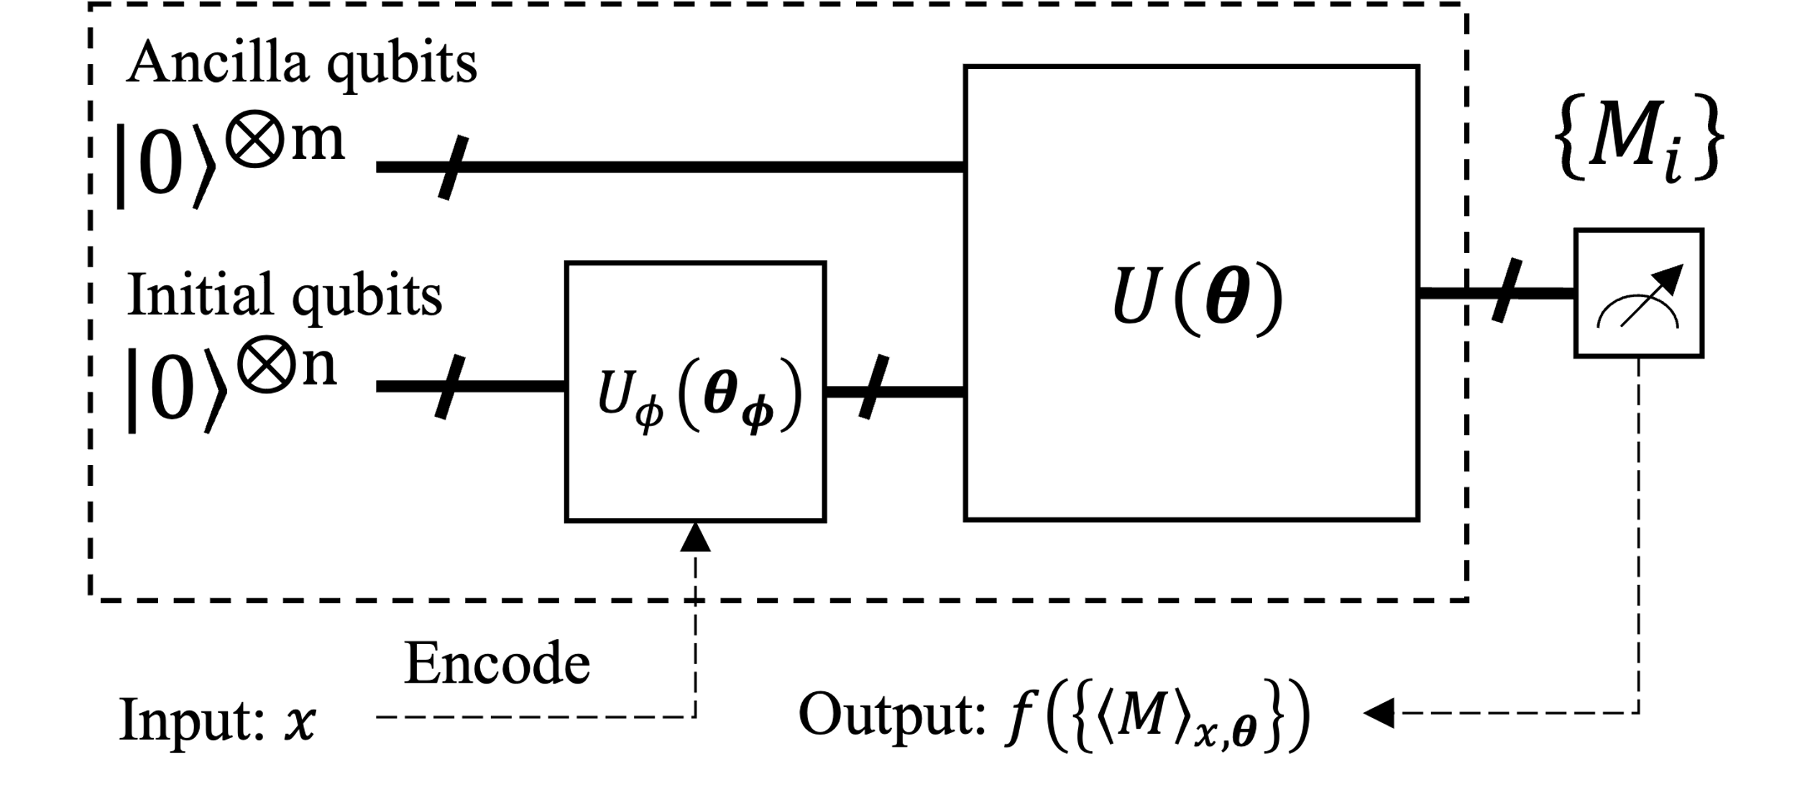

1. Parameterized quantum circuit (PQC)
Encoding circuit
Circuit/Operator
Decoder
Encoder – Decoder architecture
Fig 1.2. PQC model [2]
[2] Benedetti, M et al, Parameterized quantum circuits as machine learning models. Quantum Science and Technology, 4(4), 043001 (2019)
Notes:
Vector đầu vào được ánh xạ sang không gian Hilbert $φ(x)$ bằng Encoder $U_{φ}$.
Circuit $U(θ)$ tác động và trả về $U\left(θ\right)Uφ\left(x\right){\left|0\right\rangle }^{⊗\left(n+m\right)}$.
Tập các observable $\{M_{i}\}$ hỗ trợ thao tác đo, ánh xạ trạng thái lượng tử tới không gian output thông qua hàm $f$.
Dang 1:
- Có thể xem xét design các thuật toán dạng Grover, Shor
-
Đánh giá
- Pattern đặc biệt của từng quantum state preparation
Ví dụ, đối với quantum state preparation, pattern U nào là ngon.

Slide 4
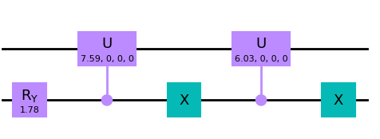
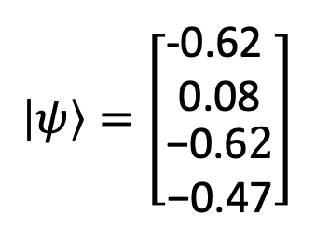
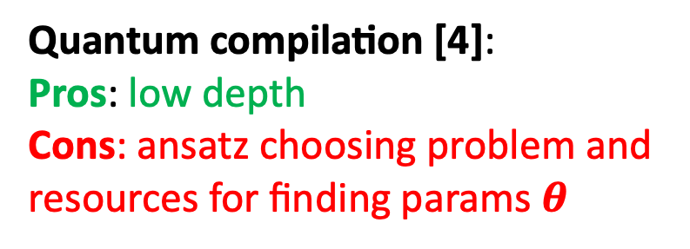
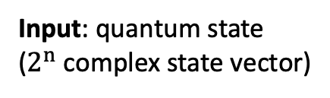
2. Methods
$$\left|ψ\right\rangle =\left[\begin{matrix}\begin{matrix}\text{−0.62 } \\ \text{0.08}\end{matrix} \\ \begin{matrix}\text{−0.6}2 \\ \text{−0.47}\end{matrix}\end{matrix}\right]$$
Encoding methods
Input: quantum state
($2^{n}$ complex state vector)
Output: encoder
(quantum circuit)
Amplitude encoding [3]:
Pros: no-computation resources for constructing circuit
Cons: very high depth
Quantum compilation [4]:
Pros: low depth
Cons: ansatz choosing problem and resources for finding params $θ$
[3] Araujo, Israel F., et al. "A divide-and-conquer algorithm for quantum state preparation." Scientific reports 11.1 (2021): 6329.
[4] S. Khatri et al., Quantum-assisted quantum compiling, Quantum 3, 140 (2019).

Slide 5
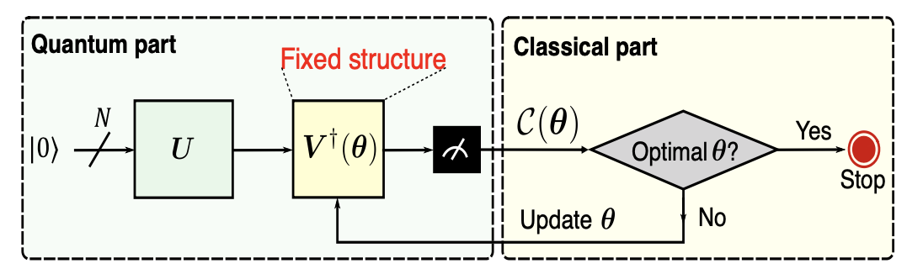
2.1. Quantum compilation [5]
Fig 2.1. A universal compilation algorithm consists of a quantum part and a classical part.
[5] Hai, V. T., & Ho, L. B. (2023). Universal compilation for quantum state tomography. Scientific Reports, 13(1), 3750

Slide 6
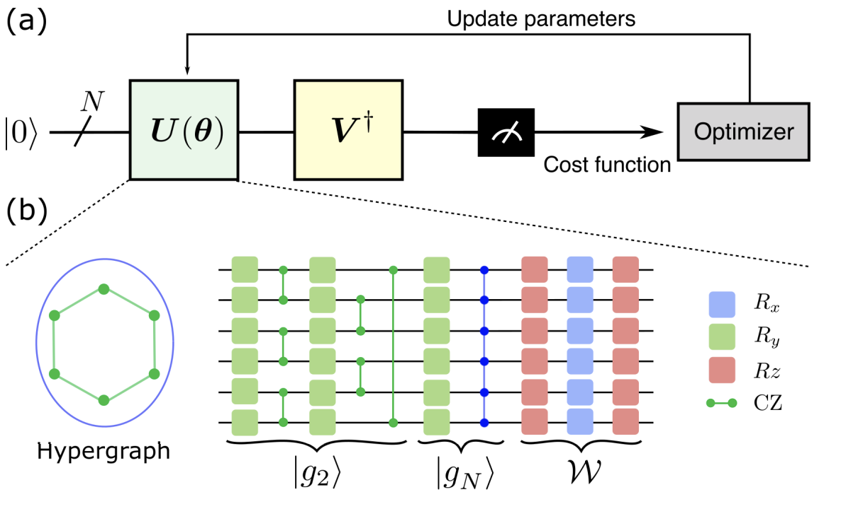
2.2. Quantum compilation: state preparation [6]
Fig 2.2. (a) Variational quantum algorithm (VQA) for quantum state preparation.
[6] Hai, V. T., Viet, N. T., & Ho, L. B. (2023). Variational preparation of entangled states on quantum computers. arXiv preprint arXiv:2306.17422.

Slide 7
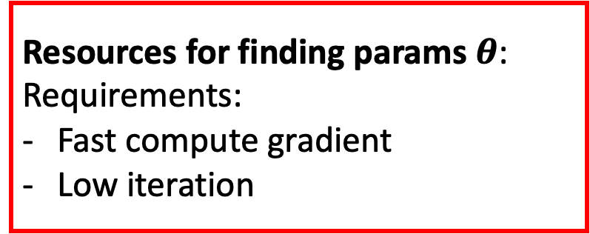
2.2. State preparation problem
Existed ansatz:
- Chain, All-to-all, … topologies
Ansatz choosing problem:
Requirements:
Universal
Still low depth (polynomial scale)
Finding new ansatz:
- Genetic algorithm
Resources for finding params $θ$:
Requirements:
Fast compute gradient
Low iteration

Slide 8
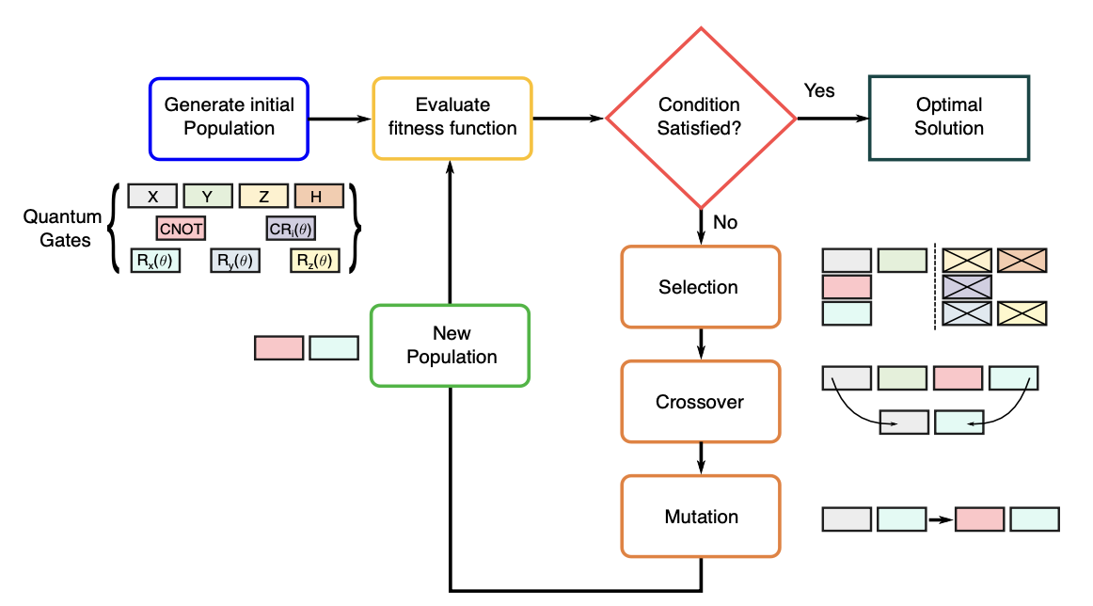
3. Genectic algorithm

Slide 9
Demos
params = {'depth': 10, 'num_individual': 8, 'num_generation': 30, 'num_qubits': 3, 'threshold': lambda loss_value: loss_value < 0.2, 'prob_mutate': 0.01}
env = environment.EEnvironment(
params,
fitness_func = compilation_fitness,
selection_func = selection.elitist_selection,
crossover_func= crossover.onepoint_crossover,
mutate_func=mutate.bitflip_mutate,
pool = qtm.constant.operations
) env.initialize_population()
env.evol()

Slide 10
1. Create population
Pool gate:
one_q_ops = [XGate, YGate, ZGate, HGate, RXGate, RYGate, RZGate]
one_param = [U1Gate, RXGate, RYGate, RZGate, RZZGate, CU1Gate, CRZGate]
two_param = [U2Gate]
three_param = [U3Gate, CU3Gate]
two_q_ops = [CXGate, CRZGate]
three_q_ops = [CCXGate, CSwapGate]

Slide 11
2. Fitness function
def fitness(qc: qiskit.QuantumCircuit):
compiler = qtm.qcompilation.QuantumCompilation(
u = qc,
vdagger = qtm.state.create_ghz_state(qc.num_qubits).inverse(),
optimizer = 'adam’,
loss_func = 'loss_fubini_study’
)
compiler.fit(num_steps = 10, verbose = 0)
return np.average(compiler.loss_values)

Slide 12
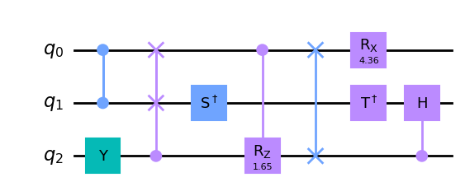
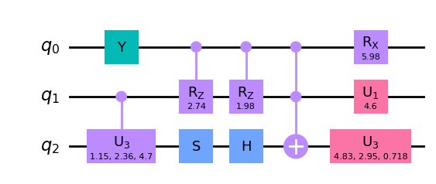
3. Crossover. Ex: percent = 0.5

Slide 13
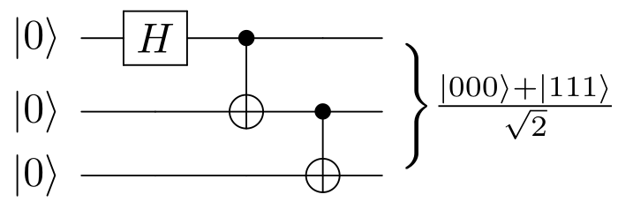
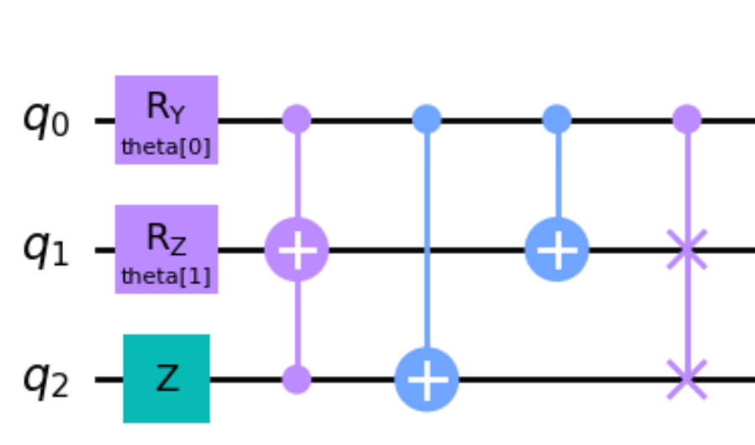
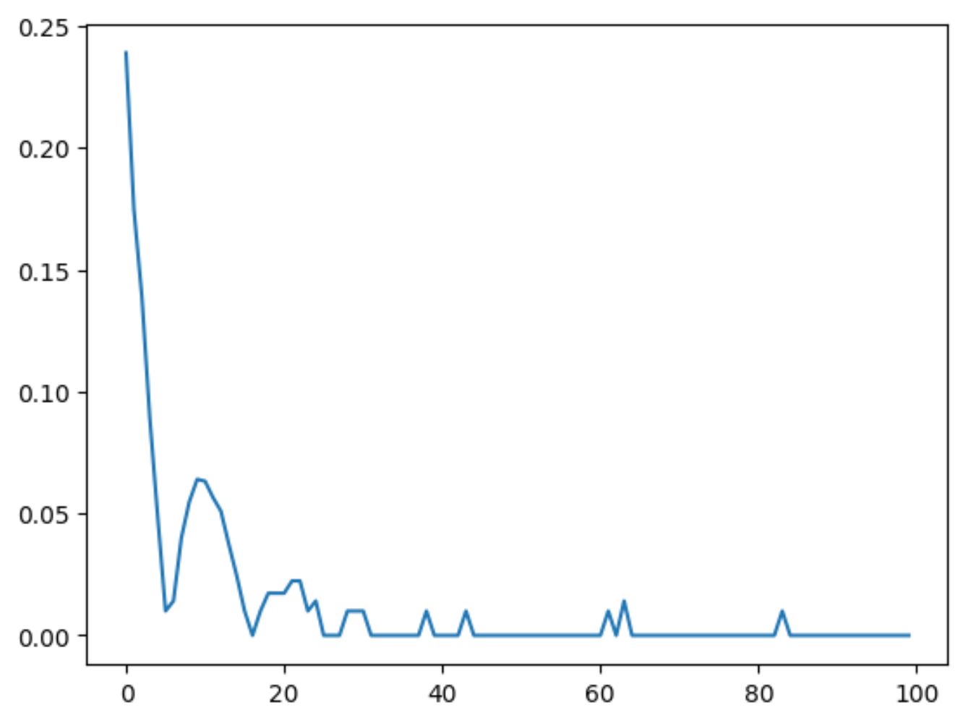
Result
Testing for finding GHZ circuit
Solution
Optimization process

Slide 14
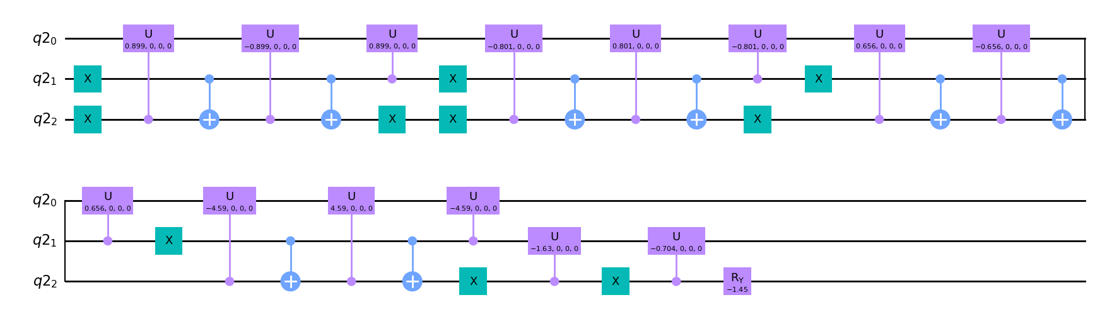
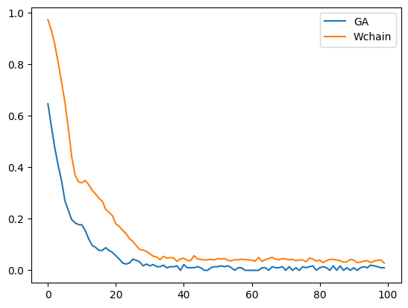
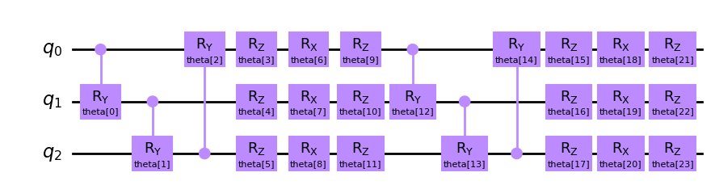
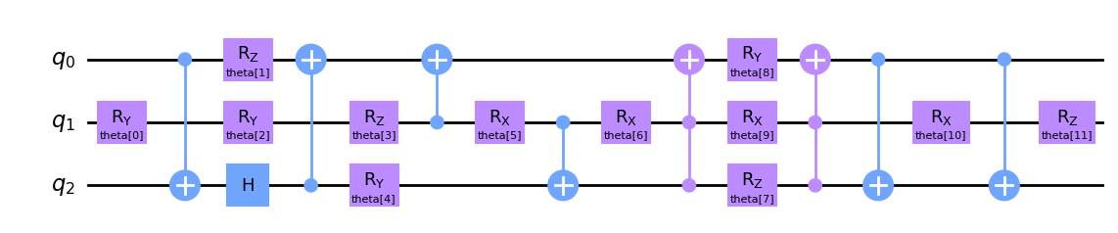


Result: Testing for finding $U_{haar}$ circuit
Generated by amplitude encoding method. Depth = 26
$W_{chain}$ ansatz. Depth = 12
Ansatz from GA. Depth = 12
Optimization process

Slide 15
Thanks for listening!

Slide 16
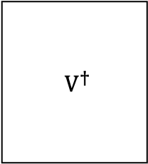

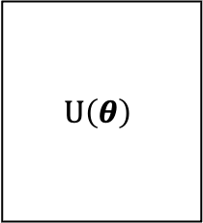







New parameter $θ$
a)
$$|0⟩$$
$$U\left(θ\right)$$
$V^{†}$
$$|0⟩$$
Optimizer
$$⋮$$
$$⋮$$
$$⋮$$
Cost value
$$|0⟩$$
b)
$$H$$
c)
$$H$$
$$†$$
=

Slide 17
Genetic algorithm
population = create_population(num_individual, num_qubits, depth)
for _ in range(maximum_generation):
population = selected(population)
new_population = []
for i in range(0, int(num_individual/2), 2):
parent_1 = population[i]
parent_2 = population[i+1]
child_1, child_2 = parent_1.crossover(parent_2)
new_population.append([child_1, child_2])
population = new_population
for individual in population:
if random.random() < prob_mutate:
individual.mutate()

Slide 18





Other parameter
Begin
Generate circuits
Initial circuits
Evaluate shortened QC process
Conditional sastified?
Optimal ansatz
End
Elitist selection
$$H$$
$$X$$
…
One-point crossover
$$R_{X}(θ)$$
$$R_{Y}(θ)$$
$$R_{Z}(θ)$$
New circuits
Bit-flip mutate
Pool gates

Slide 19





Other parameter
$$H$$
$$X$$
…
Begin
Generate population
$$R_{X}(θ)$$
$$R_{Y}(θ)$$
$$R_{Z}(θ)$$
Pool gates
Evaluate shortened QC process
Conditional sastified?
End
Elitist selection
One-point crossover
New population
Bit-flip mutate

Slide 20
a)
b)

Slide 21
Result: Testing for finding $U_{haar}$ circuit
a)
b)
d)
c)

Slide 22
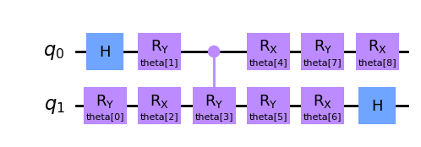
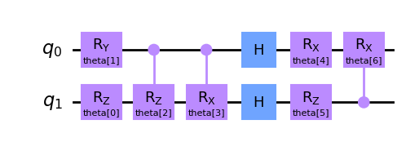
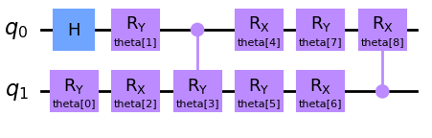
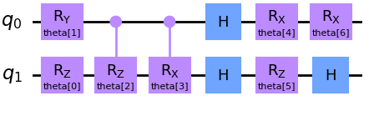
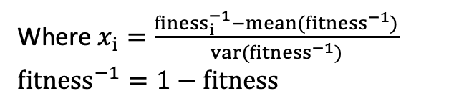
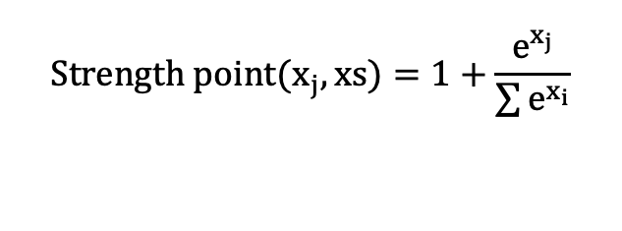
Next step: dynamic cross-over
Strength point = 5
Strength point = 1
$$Strength point(x_{j}, xs)=1+\frac{e^{x_{j}}}{\sum{e^{x_{i}}}}$$
Off-spring 1
Where $x_{i}=\frac{{finess}_{i}^{−1}−mean({fitness}^{−1})}{var({fitness}^{−1})}$
${fitness}^{−1}=1−fitness$

